Slide 1



Noida Institute of Engineering and Technology, Greater Noida
Relativistic Mechanics
Lecture - 1
Unit: I
Subject Name
Physics
Anurag Tyagi
Department of Physics
B Tech Ist year

Slide 2
Content
Introduction
Inertial & non-inertial frames
Michelson-Morley experiment
Einstein’s postulates, Lorentz transformation equations
Length contraction, Time dilation
Addition of velocities
Mass energy equivalence, Concept of Rest mass of Photon
Relativistic relation between energy and momentum

Slide 3
Course Objective
CO1: To provide the knowledge of Relativistic Mechanics and their uses to engineering applications.
CO2: To provide the knowledge of Quantum Mechanics and to explore possible engineering utilization
CO3: To provide the knowledge of interference, diffraction.
CO4: To provide the knowledge of the limitation of classical physics and ideas in solving the problems in their parent streams.

Slide 4
Course Outcome
After completion of course students are;
CO1 Able to solve the relativistic mechanics problems
CO2 Able to apply the concept of quantum mechanics
CO3 Able to develop the understanding of laws of optics and their application in various processes
CO4 Able to aware of limits of classical physics & to apply the ideas in solving the problems in their parent streams

Slide 5
CO-PO and PSO Mapping
CO | PO-1 | PO-2 | PO-3 | PO-4 | PO-5 | PO-6 | PO-7 | PO-8 | PO-9 | PO-10 | PO-11 | PO-12
CO1 | 3 | 2 | 1 | - | 2 | 2 | 2 | - | - | - | - | 2
CO2 | 3 | 2 | 1 | - | 1 | 2 | 2 | - | - | - | - | 2
CO3 | 3 | 3 | 1 | - | 2 | 2 | 2 | - | - | - | - | 2
CO4 | 3 | 2 | 2 | - | 2 | 3 | 2 | - | - | - | - | 2
Mean | 3.0 | 2.25 | 1.3 | - | 1.8 | 2.3 | 2.0 | - | - | - | - | 2.0

Slide 6
Unit Objective
To provide the knowledge of Relativistic Mechanics and frame of references and the variation in physical quantities with velocity.

Slide 7
Topic Objective
To provide the knowledge of Relativistic Mechanics and frame of references.

Slide 8
Topic Outcome
After completion of the topic students are;
Able to define relativistic mechanics and frame of references.

Slide 9
Prerequisite
Basic idea of reference of measurement
Awareness of Co-ordinate system

Slide 10
Today’s Lecture
Introduction
Inertial and Non-inertial frames of reference

Slide 11
Introduction
What is Relativistic Mechanics?
. What do you mean by word “Relative”?
. What is Relativistic?
. Length of Stick or line
. Position of Door
. Velocity of car

Slide 12
Inertial & non-inertial frames
What is frame of reference?
. Any system relative to which the motion of an object can be described is called as a frame of reference.
Types of Frame of References
Inertial frames of reference
e.g. building.
Non-Inertial frames of reference
e.g. :a car moving with variable velocity
Is Earth non-inertial frame or inertial frame ?

Slide 13
Daily Quiz
Special theory of relativity treats problems involving
Inertial frame of reference
Non-inertial frame of reference
Non-accelerated frame of reference
Accelerated frame of reference
ANS (a)
Einstein Proposed________.
Special theory of relativity
General theory of relativity
Both (a) and (b)
None of above
ANS (C)
The postulates of special theory of relativity are applicable to:
(a) Accelerated frame
(b) Inertial frame
(c) Stationary frame
(d) None of above

Slide 14
Noida Institute of Engineering and Technology, Greater Noida
Relativistic Mechanics
Lecture - 2
Unit: I
Subject Name
Physics
Anurag Tyagi
Department of Physics
B Tech Ist year

Slide 15
Topic Objective
To provide the knowledge of Galilean transformations.

Slide 16
Topic Outcome
After completion of the topic students are;
Able to apply Galilean transformations.

Slide 17
Recap
Frames of reference and their types
Inertial and Non-Inertial frames

Slide 18
Today’s Lecture
Transformation Equations
Galilean Transformations

Slide 19
Galilean transformations
What do you mean by transformation equation?
A set of equations which relates the position and time measured in one inertial frame of reference into another inertial frame of reference.
Galilean Transformation Equations

Slide 20
Galilean transformations Contd..
Inverse Galilean Transformations Equations
For velocity
For acceleration
In all inertial frames a body will be observed to have the same acceleration.

Slide 21
Daily Quiz
In special theory of relativity, the two frames of reference are called
Accelerated frames
non-inertial frames
Inertial frames
all of these
In special theory of relativity shows that Newtonian mechanics is valid at
velocities much smaller than that of light
velocities nearer to that of light
all velocities
velocities much greater than that of light

Slide 22
MCQ s
Special theory of relativity treats problems involving
Inertial frame of reference
Non-inertial frame of reference
Non-accelerated frame of reference
Accelerated frame of reference
ANS (a)
Einstein Proposed________.
Special theory of relativity
General theory of relativity
Both (a) and (b)
None of above
ANS (C)
The postulates of special theory of relativity are applicable to:
(a) Accelerated frame
(b) Inertial frame
(c) Stationary frame
(d) None of above

Slide 23
Old Papers Questions
What are inertial and non-inertial frames of reference? Explain whether earth is inertial frame or non inertial frame . [2009, 2014, 2018]
Differentiate inertial and non inertial frames of reference and show that inertial frames move with constant velocity relative to each other. [2006, 2008, 2011]
What do you understand by frame of reference? Is earth an inertial frame of reference? If not, why? [2008]
What are inertial and non-inertial frames of reference? Explain each with suitable example. [2012]
Derive Galilean transformation equation. [2000, 2018]
Show that velocity is variant and acceleration is invariant under Galilean transformation. [2015]

Slide 24
Noida Institute of Engineering and Technology, Greater Noida
Relativistic Mechanics
Lecture - 3
Unit: I
Subject Name
Physics
Anurag Tyagi
Department of Physics
B Tech Ist year

Slide 25
Topic Objective
To provide the knowledge of Michelson-Morley experiment.

Slide 26
Topic Outcome
After completion of the topic students are;
Able to formulate the relation for path difference with Michelson-Morley experiment.

Slide 27
Recap
Frames of reference and their types
Inertial and Non-Inertial frames

Slide 28
Today’s Lecture
Aim/Objective of Michelson-Morley experiment
Experimental arrangement
Calculation for time difference

Slide 29
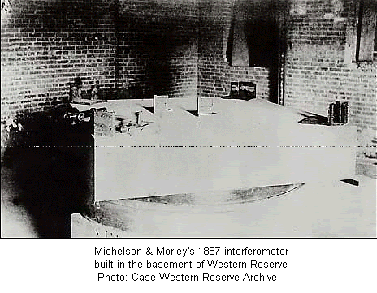
Michelson-Morley experiment
Aim of the Michelson-Morley experiment
To confirm the existence of absolute stationary frame of reference i.e. ETHER frame and to determine the absolute velocity of earth w.r.t. ETHER frame in order to detect the change in the velocity of light.
Actual Experimental setup

Slide 30
Michelson-Morley Experimental arrangement
Mirror M₁
A
v
Source of light S
B
Semi Silvered
Glass plate
Mirror
M₂
T
Telescope

Slide 31
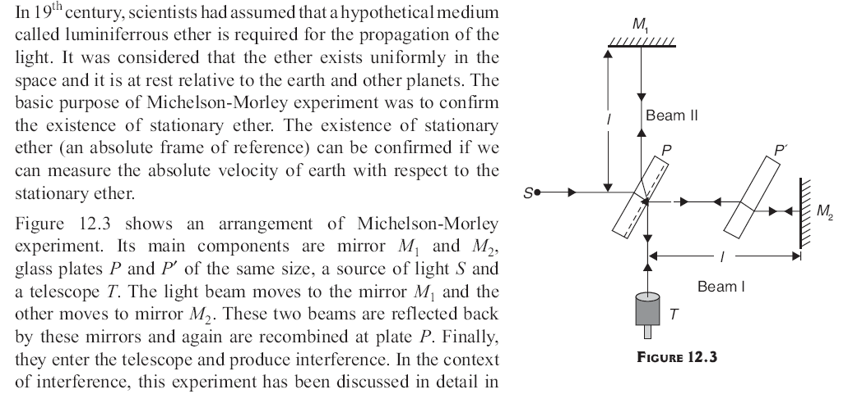
Michelson-Morley Experimental arrangement

Slide 32
Michelson-Morley Experimental arrangement

Slide 33

Calculation of time in perpendicular direction
A
A
M₁
M₁
vt
P
O
P

Slide 34
Michelson-Morley Experimental arrangement

Slide 35
Michelson-Morley Experimental arrangement

Slide 36
Calculation of time in the direction of incident light
v
P
c
P’
B
B’
M₂
M’₂

Slide 37
Calculation for optical path difference
If t₁ and t₂ be the time taken by ray 1 and ray 2 to travel the whole path, then
Time difference
Δt= t₂– t₁ = lv²/c³
Optical path difference between two rays is given by
Δ= lv²/c²

Slide 38
Noida Institute of Engineering and Technology, Greater Noida
Relativistic Mechanics
Lecture - 4
Unit: I
Subject Name
Physics
Anurag Tyagi
Department of Physics
B Tech Ist year

Slide 39
Topic Objective
To provide the knowledge of outcome Michelson-Morley experiment.

Slide 40
Topic Outcome
After completion of the topic students are;
Able to conclude the outcome of Michelson-Morley experiment.

Slide 41
Recap
Aim of Michelson-Morley experiment
Calculation for time difference

Slide 42
Today’s Lecture
Fringe shift in Michelson-Morley experiment
Negative result of Michelson-Morley Exp.
Interpretation of the negative result

Slide 43
Calculation for fringe shift
The path difference =nλ
n₁= lv²/ λ c²
When apparatus rotate through 90⁰ then the path difference become -lv²/c² ⇒ n₂= -lv²/ λ c²
Now fringe shift N (Δ n)= n₁- n₂= 2lv²/ λ c²=0.4 fringe

Slide 44
Negative result and It’s Interpretation
Negative result of Michelson-Morley Experiment
In M-M experiment the expected fringe shift was 0.4 but practically no fringe shift was observed. Thus the relative velocity of earth w.r.t. the stationary Ether could not be detected. Hence, the hypothesis of existence of stationary medium ETHER was disapproved. This is the negative result of M-M experiment.
Interpretation of negative result
.The ETHER dreg hypothesis (theory)
. Lorentz Fitzgerald contraction hypothesis
.Constancy of speed of light hypothesis

Slide 45
Daily Quiz
Michelson and Morley experiment was designed to measure
The relativistic mass of an electron
The relativistic energy of electron
The velocity of earth relative to ether
The acceleration of gravity on earth surface

Slide 46
MCQ
Whose experimental work proved that the velocity of light is universal and natural constant?
Lorentz
Michelson and Morley
Einstein
Maxwell

Slide 47
Old Papers Questions
What was the main objective and out come of Michelson –Morley Experiment? Describe the Experiment . How is the negative result of the experiment interpreted?
[2003, 2006, 2007, 2009, 2010,2013, 2017]
Discuss briefly Michelson-Morley experiment and mention its outcome. [2003, 2010, 2017]
How is the negative result of Michelson-Morley experiment interpreted? State the fundamental postulates of special theory of relativity. [2005, 2008, 2011]

Slide 48
Weekly Assignment
Define inertial and non-inertial frames of reference.
What was the objective of Michelson-Morley experiment?
What was the negative result of Michelson-Morley experiment?
How the negative result of the Michelson-Morley experiment was interpreted?
What was the significance of Michelson-Morley experiment.

Slide 49
Noida Institute of Engineering and Technology, Greater Noida
Relativistic Mechanics
Lecture - 5
Unit: I
Subject Name
Physics
Anurag Tyagi
Department of Physics
B Tech Ist year

Slide 50
Topic Objective
To provide the knowledge of Lorentz transformations.

Slide 51
Topic Outcome
After completion of the topic students are;
Able to apply the Lorentz transformations.

Slide 52
Recap
Fringe shift in Michelson-Morley experiment
Negative result of Michelson-Morley Exp.
Interpretation of the negative result

Slide 53
Today’s Lecture
Einstein’s Postulates of Special Theory of Relativity
Lorentz’s Transformation Equations

Slide 54
Einstein’s postulates of S T R
There are two postulates of special theory of relativity
Postulate 1 :
The fundamental laws of physics have same form in all inertial frames of reference.
Postulate 2:
The velocity of light in vacuum is independent of the relative motion of source and the observer and is constant , c, in all directions.

Slide 55
Lorentz transformation equations
Galilean Transformations are not suitable under the new concept of special theory of relativity, where the speed of the object or observer is comparable with the speed of light.
Lorentz developed new transformations based on Einstein’s postulates of special theory of relativity.
y
y´
S
S’
v
P
O
O´
x
x´
z
z´

Slide 56
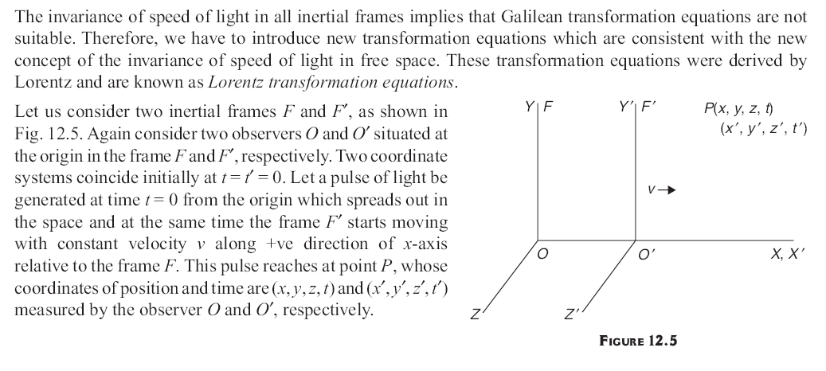
Lorentz Transformation Equations

Slide 57
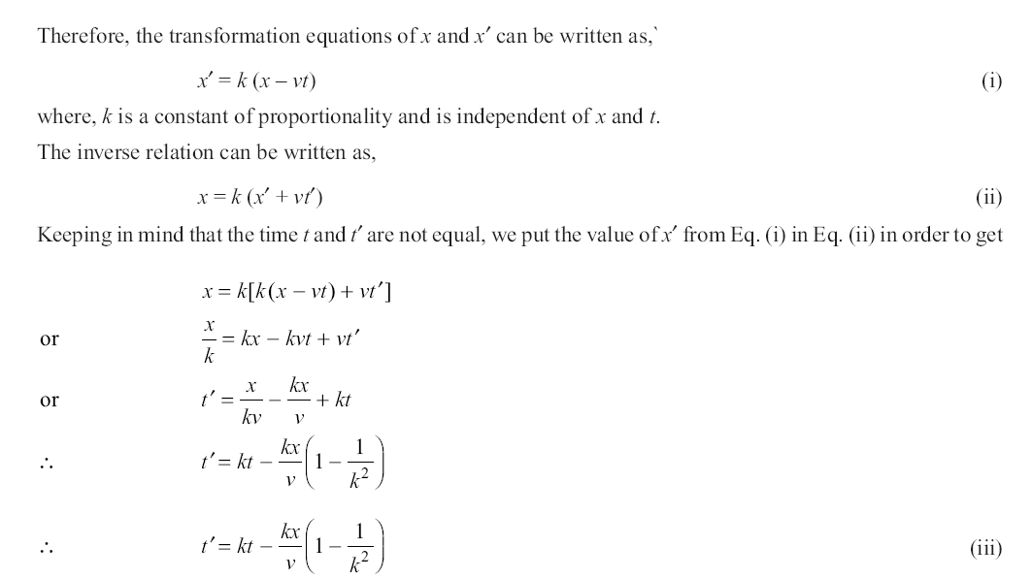
Lorentz Transformation Equations

Slide 58
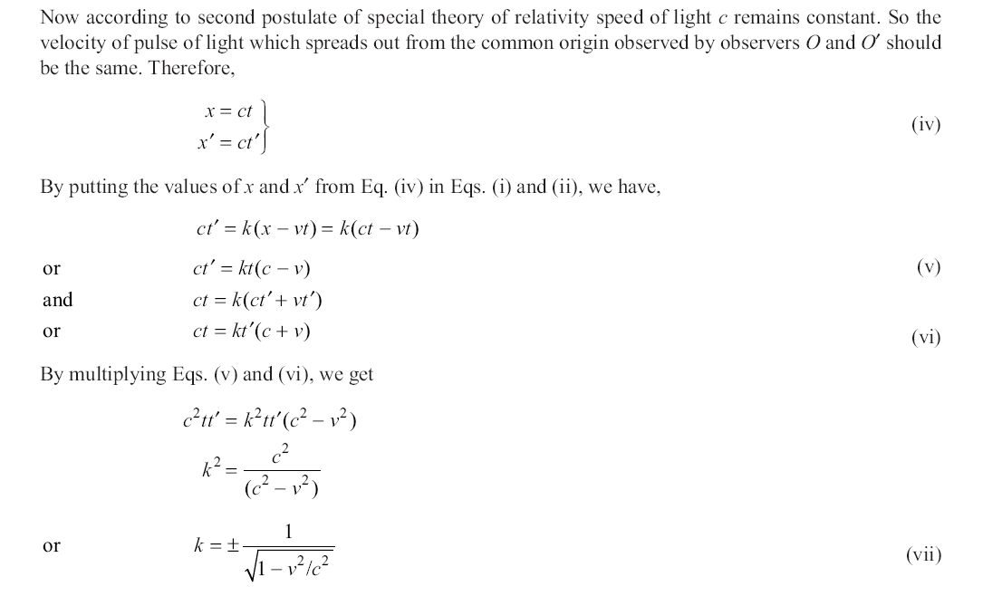
Lorentz Transformation Equations

Slide 59
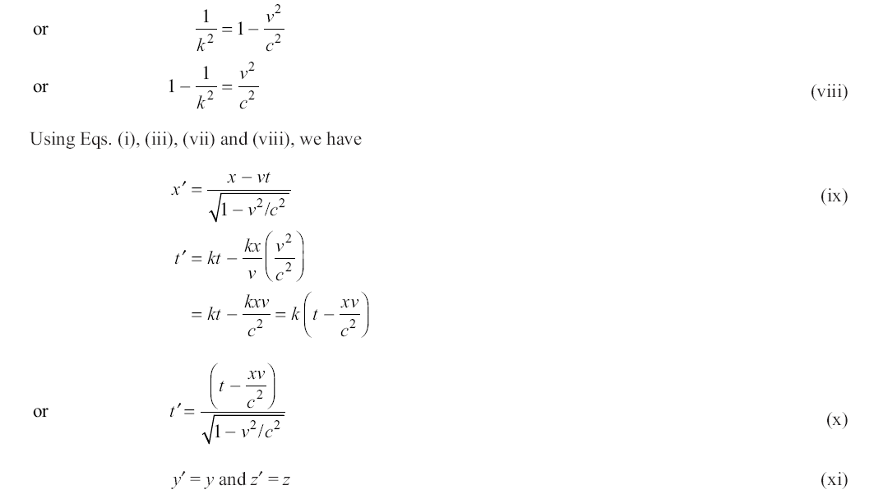
Lorentz Transformation Equations

Slide 60
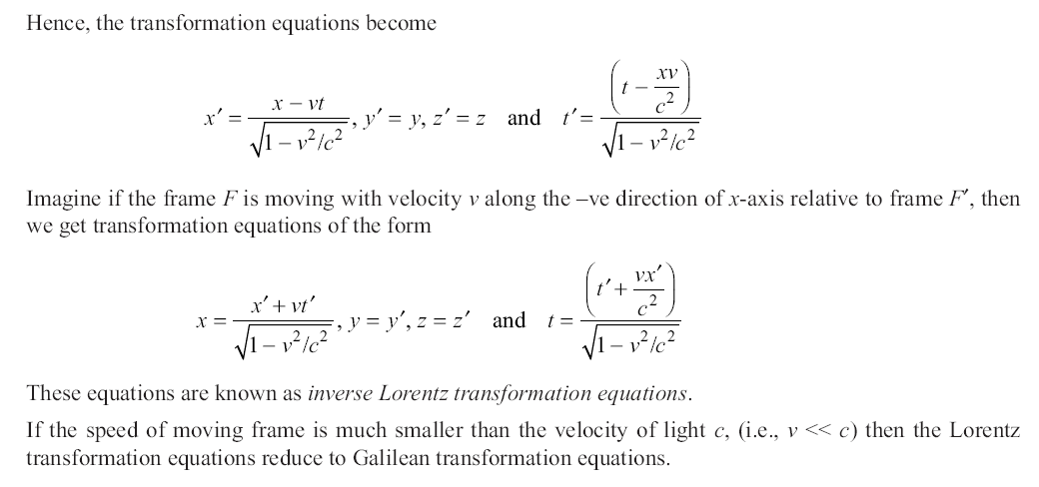
Lorentz Transformation Equations

Slide 61
Lorentz transformation equations

Slide 62
Inverse Lorentz Transformation equations

Slide 63
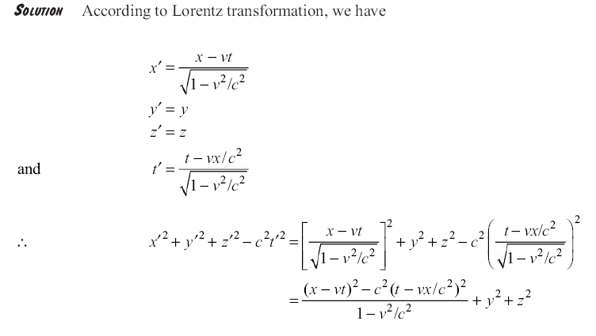
Lorentz Transformation Equations

Slide 64
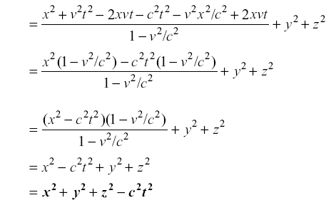
Lorentz Transformation Equations

Slide 65
Daily Quiz
According to special theory of relativity which one is not an absolute quantity
Time
mass
height
both a and b
Length contraction happens only
Perpendicular to direction of motion
Along direction of motion
Parallel to direction of motion
Both a and b
Michelson and Morley experiment showed that
Newtonian mechanics is correct for all low and high velocities
There is an absolute ether frame
There is no absolute ether frame, but all frames are relative
Velocity of light is relative in all cases

Slide 66
MCQs
In accordance of special theory of relativity if u and u’ be the velocities of a particle in the laboratory and in the moving frames respectively, then which of the following relations is correct.
y’=y-vt
u’_{y} = u_{y}
u’_{z} = u_{z}
none of these
The postulates of special theory of relativity are applicable to
Accelerated frame
Inertial frame
Stationary frame
None of these

Slide 67
Old Papers Questions
State the fundamental postulates of special theory of relativity. Deduce the Lorentz transformation equation.
[2001, 2002, 2005, 2006, 2010, 2015]
State Einstein's postulates of special theory of relativity. Explain why Galilean relativity failed to explain the actual results of Michelson-Morley and hence obtained Lorentz transformation. [2006, 2018]
Derive the Galilean transformation formula. State the fundamental postulates of special theory of relativity. Deduce the Lorentz transformation equation. [2000, 2018]

Slide 68
Noida Institute of Engineering and Technology, Greater Noida
Relativistic Mechanics
Lecture - 6
Unit: I
Subject Name
Physics
Anurag Tyagi
Department of Physics
B Tech Ist year

Slide 69
Topic Objective
To provide the knowledge of Length contraction and time dilation.

Slide 70
Topic Outcome
After completion of the topic students are;
Able to solve the problems of length contraction and time dilation.

Slide 71
Recap
Einstein’s Postulates of Special Theory of Relativity
Lorentz’s Transformation Equations

Slide 72
Today’s Lecture
Length contraction
Time dilation

Slide 73

Length contraction
The appeared length of the body in the direction of motion decreases, is called length contraction. This is given as
L₀= actual length or proper length
L= appeared length or non proper length

Slide 74
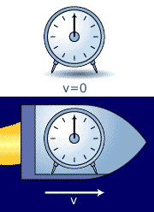
Time dilation
A clock in a moving frame of reference (S’) measure a longer time interval between two events that occur in a stationary frame of reference than the same time interval measured by the clock in stationary frame(S).

Slide 75
Length Contraction

Slide 76
MCQs
If a train were to move with velocity of light, its length would be
finite
infinite
unchanged
zero
The length of an object will be maximum when it is
moving with speed v<<c
Moving with speed,
at rest
none of these
Decay of μ meson supports
Time dilation
Relativity of mass
Length contraction
Relativity of energy

Slide 77
Old Papers Questions
What do you mean by length contraction at relativistic speed? Deduce the necessary expression for it. [2004, 2016]
What do you understand by time dilation? Describe experimental evidence to show time dilation is a real effect. [2003, 2005, 2006, 2007, 2008, 2010, 2012, 2013, 2018]
Show that a clock moving with velocity ‘v’ relative to an observer appears to him go slow by a factor of then at rest relative to him. [2006, 2009, 2018]

Slide 78
Noida Institute of Engineering and Technology, Greater Noida
Relativistic Mechanics
Lecture - 7
Unit: I
Subject Name
Physics
Anurag Tyagi
Department of Physics
B Tech Ist year

Slide 79
Topic Objective
To provide the knowledge of addition of velocities.

Slide 80
Topic Outcome
After completion of the topic students are;
Able to apply the concept of addition of velocities.

Slide 81
Recap
Length contraction
Time dilation

Slide 82
Today’s Lecture
Addition of relativistic velocities

Slide 83
Addition of velocities
Let u be the velocity of a particle in frame S, u’ is the velocity of particle in frame S’ and v be the velocity of frame S’ relative to S then

Slide 84
MCQs
Two photons approach each other. There relative velocity will be
Zero (b) c/2 (c) c (d) 2c
Two particles are moving in opposite directions each with a speed of 0.9c. The velocity of one particle relative to other is
zero (b) 1.8c (c) 0.994c (d) 0.9c
An electron is chased by a photon. The speed of the electron is 0.9c. Their relative velocity is
0.1c (b) c (c) 0.9c (d) none of these

Slide 85
Old Papers Questions
Deduce the relativistic addition theorem. Show that it is consistent with Einstein’s second postulate.
[2002, 2003, 2005, 2007, 2010, 2018]
Obtain the expression for the addition of the relativistic velocities. Show that ‘c’ is invariant.
[2004, 2008, 2012, 2013, 2018]

Slide 86
Noida Institute of Engineering and Technology, Greater Noida
Relativistic Mechanics
Lecture - 8
Unit: I
Subject Name
Physics
Anurag Tyagi
Department of Physics
B Tech Ist year

Slide 87
Topic Objective
To provide the knowledge of variation of mass with velocity.

Slide 88
Topic Outcome
After completion of the topic students are;
Able to solve the problems of variation of mass.

Slide 89
Recap
Addition of relativistic velocities

Slide 90
Today’s Lecture
Variation of mass with relativistic velocity

Slide 91
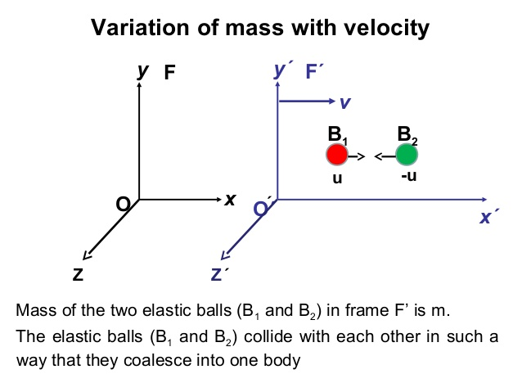
Variation of mass with velocity

Slide 92
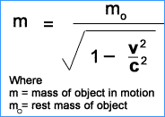
Variation of mass with velocity Contd..
Inferences from above relation:
When v << c, v²/c² may be ignored as compared to 1, above equation gives m = m₀
When
It means no material particle can travel faster than speed of light.

Slide 93
MCQs
On the surface of the earth, the mass of a man is 100 kg. When he is in rocket moving with a speed of 4.2 × 10⁷ m/s relative to the earth what will be his mass as observed by an observer in the rocket.
99 Kg (b) 100 Kg (c) 101 Kg (d)none of these

Slide 94
Old Papers Questions
Deduce an expression for the variation of mass with velocity. [2001, 2005, 2008, 2009, 2012, 2016]
Show that if the variation of mass with velocity is taken into account, the kinetic energy of a particle of rest mass m₀ and moving with w velocity v is given as –
[2003, 2006, 2009, 2013]

Slide 95
Weekly Assignment
What are the Einstein’s postulates of Special Theory of Relativity ?
What was the reason to develop the Lorentz’s transformation equations?
What do you understand by Length contraction and Time dilation?
Derive relativistic velocity addition theorem.
Show that no material particle can attain the speed of light.

Slide 96
Noida Institute of Engineering and Technology, Greater Noida
Relativistic Mechanics
Lecture - 9
Unit: I
Subject Name
Physics
Anurag Tyagi
Department of Physics
B Tech Ist year

Slide 97
Topic Objective
To provide the knowledge of Einstein’s mass energy relation.

Slide 98
Topic Outcome
After completion of the topic students are;
Able to solve the problems of mass energy relation.

Slide 99
Recap
Variation of mass with relativistic velocity

Slide 100
Today’s Lecture
Einstein’s mass energy relation
Concept of rest mass

Slide 101
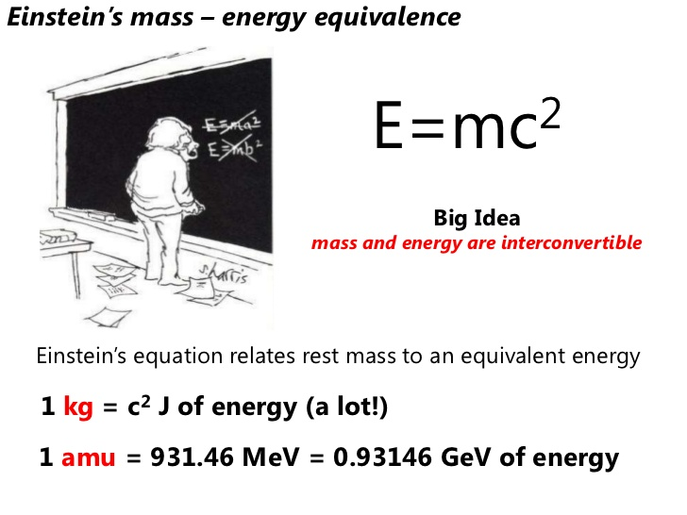
Mass Energy equivalence

Slide 102
Concept of Rest mass of Photon
From variation of mass relation:
Rest mass of Photon
For photon v=c

Slide 103
Noida Institute of Engineering and Technology, Greater Noida
Relativistic Mechanics
Lecture - 10
Unit: I
Subject Name
Physics
Anurag Tyagi
Department of Physics
B Tech Ist year

Slide 104
Topic Objective
To provide the knowledge of relativistic momentum.

Slide 105
Topic Outcome
After completion of the topic students are;
Able to develop the relation of relativistic momentum.

Slide 106
Recap
Einstein’s mass energy relation
Concept of rest mass

Slide 107
Today’s Lecture
Relativistic Momentum
Relativistic energy and momentum relation

Slide 108
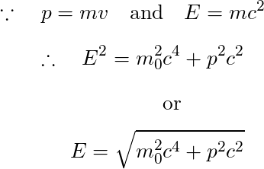
Relativistic relation
between energy and momentum
where
E = relativistic total energy
p = relativistic momentum
m₀= rest mass

Slide 109
Faculty Video Links, Youtube & NPTEL Video Links and Online Courses Details
Self Made Video Link:
Youtube/other Video Links
https://www.youtube.com/watch?v=lzBKlY4f1XA&list=PL10WTjZXSIlHKMnU4UCxpPsH-yAf_n1O6&index=11

Slide 110
Old Papers Questions
Drive Einstein’s mass - energy relation.
[2001, 2005, 2008, 2009, 2012, 2016]
Explain the concept of rest mass of photon. [2010, 2016]

Slide 111
Weekly Assignment
Derive Einstein’s mass energy relation.
How relativistic momentum is associated with relativistic energy, derive relation?
What is the concept of rest mass of photon?
Show that particle having zero rest mass, travels with the speed of light.

Slide 112
Expected Questions for University Exam
What type of frame is earth, explain?
Explain Michelson-Morley experiment. How the negative result was interpreted?
What are Einstein’s postulate of special theory of relativity? Derive Lorentz’s transformation equations.
Derive relativistic velocity addition theorem.
How mass of an object varies at relativistic velocities, derive the relation?
Derive Einstein’s mass energy relation.

Slide 113
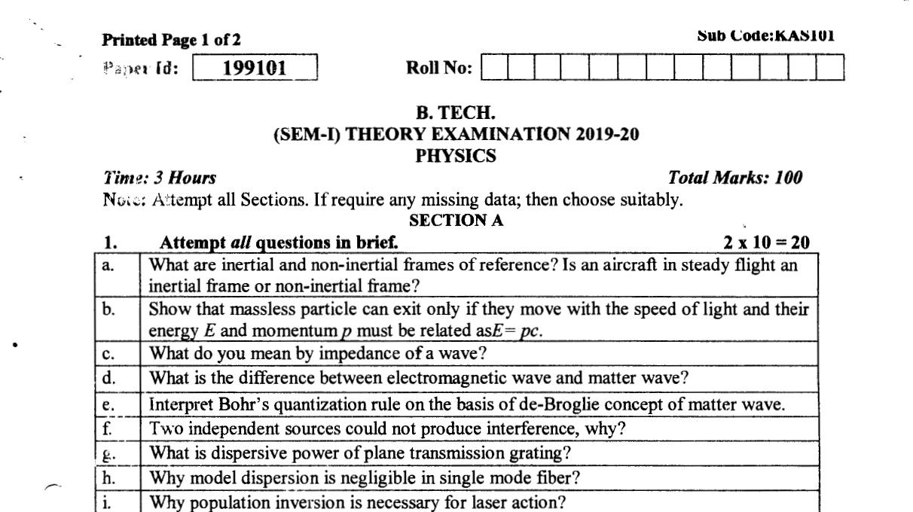
Old University Question Papers

Slide 114
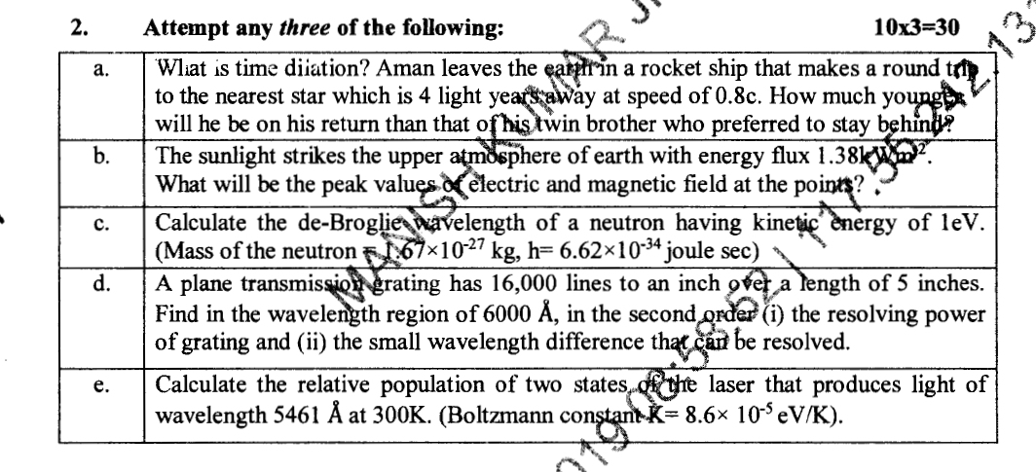
Old University Question Papers

Slide 115
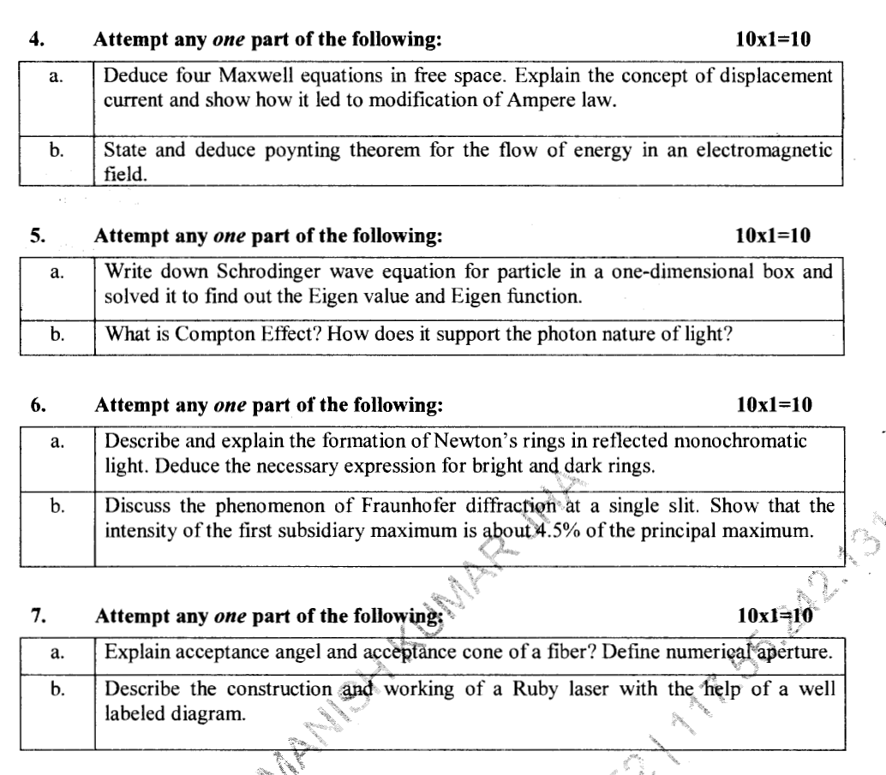
Old University Question Papers

Slide 116
Summary
Length, Position, Velocity , Time are not absolute.
In all inertial frames a body will be observed to have the same acceleration.
The fundamental laws of physics have same form for all inertial system.
The velocity of light in vacuum is independent of the relative motion of source and the observer.
Length of a body, mass and time depends on its velocity.
Mass can be converted into energy and energy can be converted into mass.

Slide 117
References
“Mechanics and Relativity” by Soni V S
“Classical Mechanics And Relativity” by Harald J W Muller Kirsten
“The Britannica Guide to Relativity and Quantum Mechanics (Physics Explained)” by Erik Gregersen

